Slide 1

CASE STUDY
Research project by Soutrik Basu

Slide 2
Content
Overview
Objective
Data Analysis
Table Analysis
Factors to understand and optimize business.

Slide 3
Overview
• This case study consists of 3 data sets (Real data downloaded from ‘Kaggle’) consisting of products of coca-cola in different region sold by different retailers.
• The case study examines the sales of Coca-Cola across different regions.
• Also analyze the retailer performance (Region and City wise) for each products of Coca-Cola.

Slide 4
Objective
1. Sales Performance Analysis:
• To analyze sales performance trends of Coca-Cola across different retailers.
2. Retailer Segmentation:
• To segment Coca-Cola's retailers based on sales performance in various regions and cities.
3. Product Performance:
• To develop a predictive model for Coca-Cola product demand across various retailers to improve inventory.
4. Market Expansion Strategy
• To identify underserved regions or retail segments where Coca-Cola can expand or increase its market presence.

Slide 5
Data Analysis
Analyze the data set for different aspects of sales of Coca-Cola brands with respect to Region, State, and City for the year 2022.
Also analyze the Retailer and Coca-Cola company relationship with respect to the sales and profits made by each retailers in each region.

Slide 6

Table Analysis
• The data set consists of 3 tables.
• Table ‘Cocacola’ consists of overall details of date wise sales of the Coca-Cola brands in respective regions.
• Table ‘Country’ contains the Country ID of city from the State and Country they belong.
• Table ‘Retailer’ contains retailer names and the retailer ID they are assigned to.

Slide 7
Factors to understand and optimize business
• Monthly sales trend for brand 'Coca-Cola'
• Products as per their operating profit.
• Retailer wise sales figure.
• Average selling quantity per retailer per month.
• Retailers preference in terms of delivery partner
• Detailed regional sales performance.
• Top 5 State with highest sales.
• Total sales revenue per product.
• Top 3 best selling product.
• Which brand is the most popular by region.

Slide 8
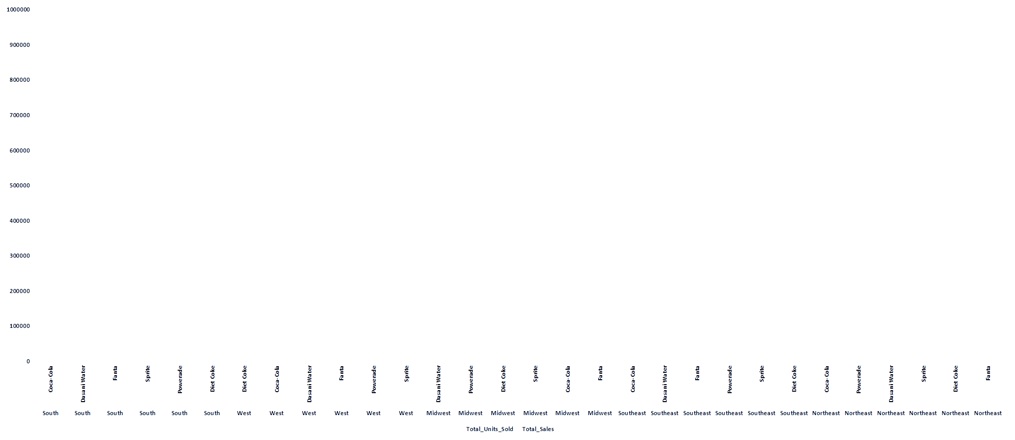
Detailed regional sales performance

Slide 9
• The previous graph represents regional wise sales performance of each brand.
• Here it has been observed that Coca-Cola is the highest selling brand in all the region.

Slide 10
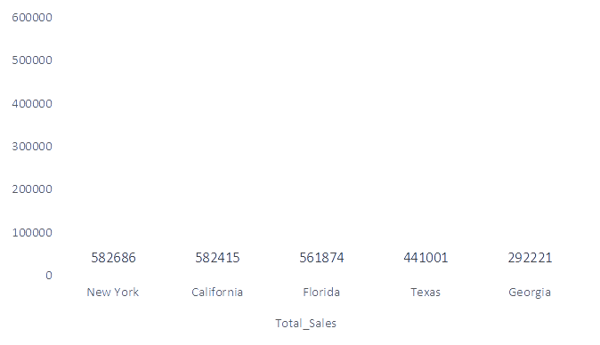
Top 5 State with highest sales.
• This graph represents top 5 state with highest sales.
• From this chart we can see that New York has the highest sales.
• This graph indicates that Georgia has the lowest sales among the top 5 states.

Slide 11
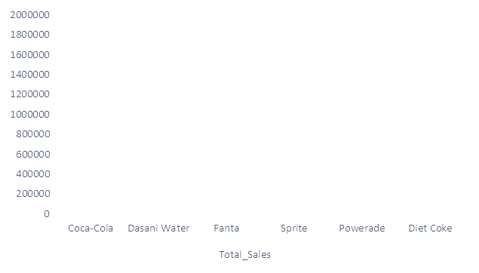
Total sales revenue per product
• This graph represents total sales revenue of each product/ brand.
• From this chart we can see that Coca-Cola brand has the highest sales.
• The graph shows that Fanta has the lowest sales among all the brands.

Slide 12
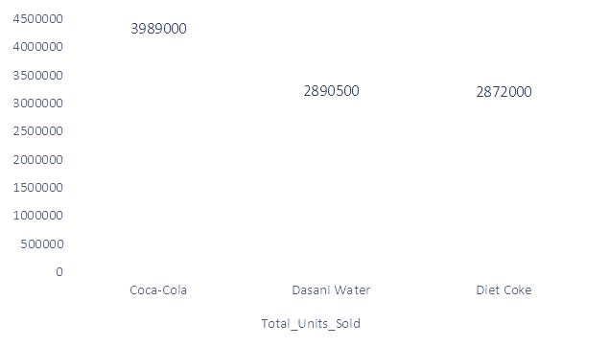
Top 3 best selling product across all region
• This graph represents top 3 best selling product across all region
• From this chart we can see that Coca-Cola brand is being sold the most.

Slide 13
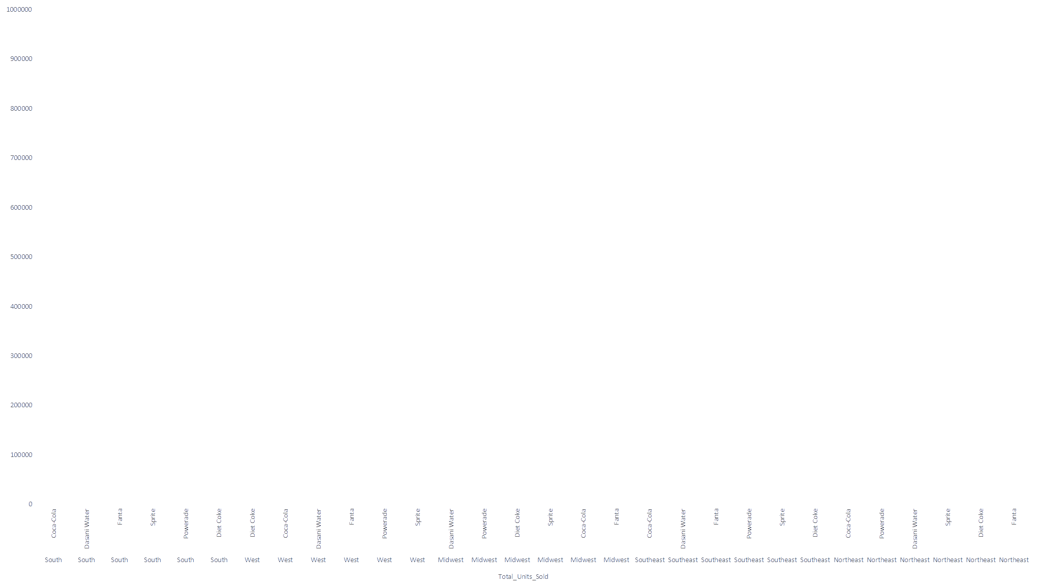
Which brand is the most popular by region

Slide 14
• The previous graph represents regional wise popularity of each brand.
• Here it has been observed that sales of brand: Coca-Cola is highest in every region(South, West, Midwest, Southeast, northeast).
• In South, least popular brand is Powerade. In West, least popular brand is Powerade.
• In Midwest, Southeast and Northeast, least popular brand is Fanta.

Slide 15
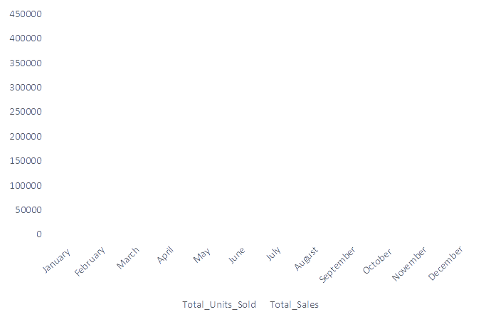
Monthly sales trend for brand 'Coca-Cola'
• This graph represents monthly sales analysis of brand : 'Coca-Cola'.
• This graph contains month wise total sales amount data and total units sold data.
• From this chart we can determine that 'Coca-Cola' is being sold the most in the month of July.

Slide 16
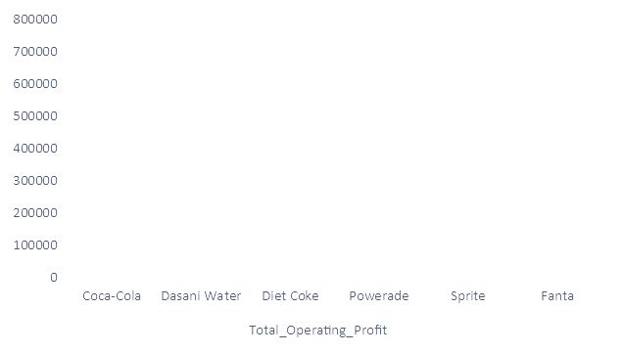
Products as per their operating profit
• This graph represents total operating profit of the products.
• From this chart we can determine that 'Coca-Cola' has the highest operating profit.
• However 'Fanta' has the lowest operating profit.

Slide 17
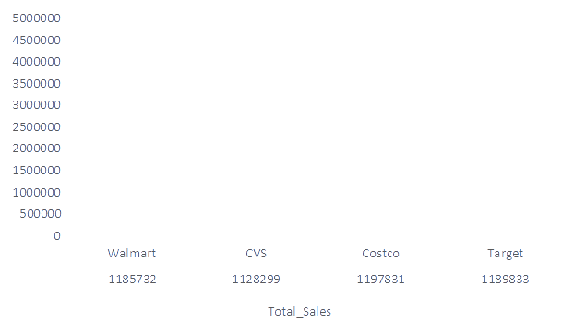
Retailer wise sales figure.
• This graph represents total sales of each Retailer along with the Retailer ID.
• From this chart we can determine that Retailer: 'Walmart' (Retailer ID : 1185732) has the highest sales.
• From this chart we can determine that Retailer: 'Target' (Retailer ID : 1189833) has the lowest sales.

Slide 18
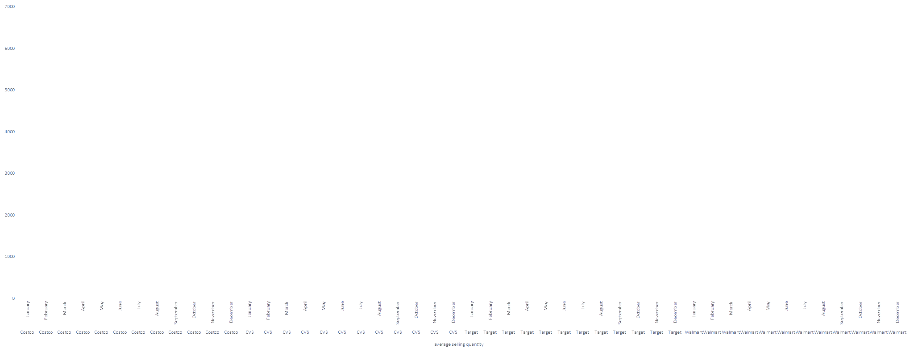
Average selling quantity per retailer per month

Slide 19
• The previous graph represents average quantity of the product sold to each retailer.
• Here in the graph it has been observed that month of JULY has the highest average quantity sold for every retailers.

Slide 20
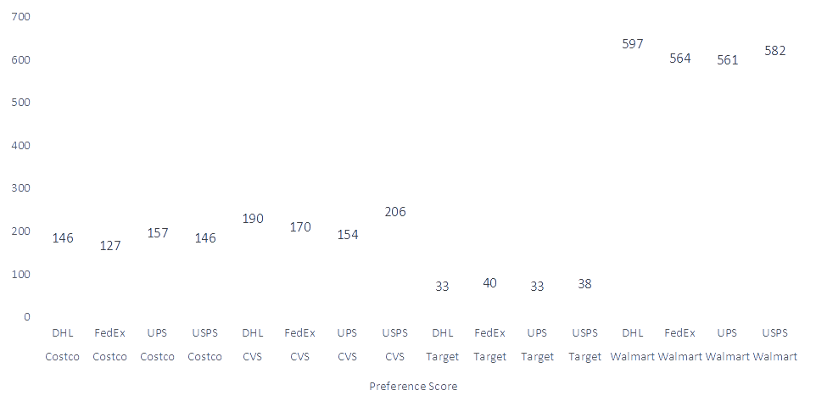
Retailers preference in terms of delivery partner

Slide 21
• The previous graph represents the delivery partner preferred by each retailer.
• From the graph it has been observed that :
- COSTO prefers UPS as their best delivery partner.
- CVS prefers USPS as their best delivery partner.
- TARGET prefers FedEx as their best delivery partner.
- WALMART prefers DHL as their best delivery partner.

Slide 22
Thank You

